Slide 1


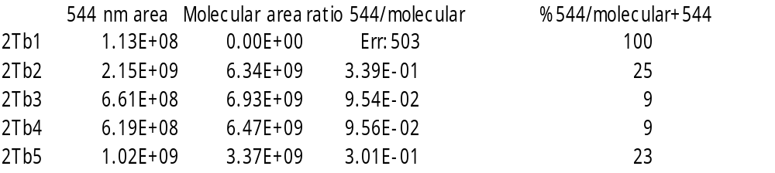
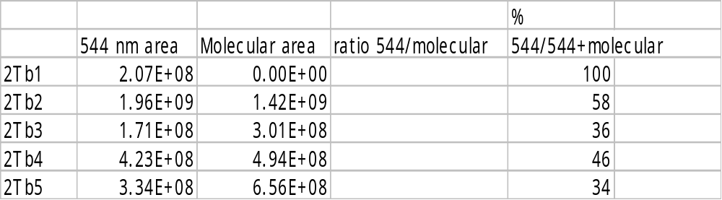
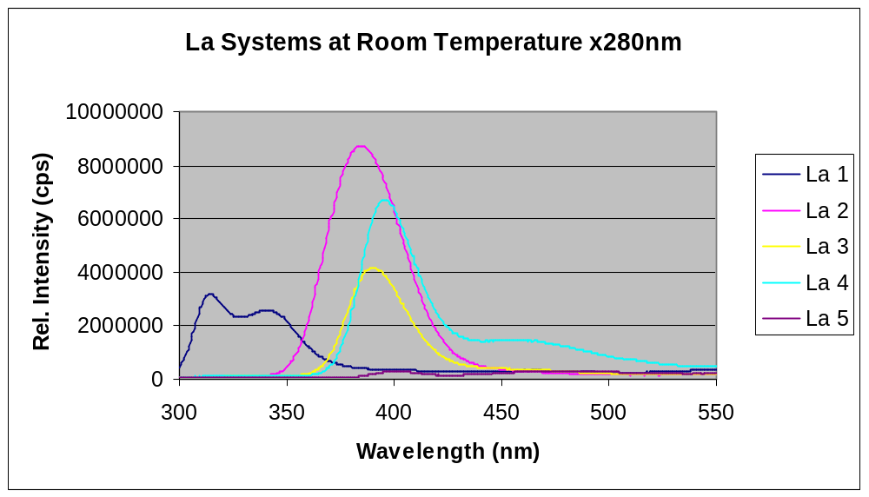
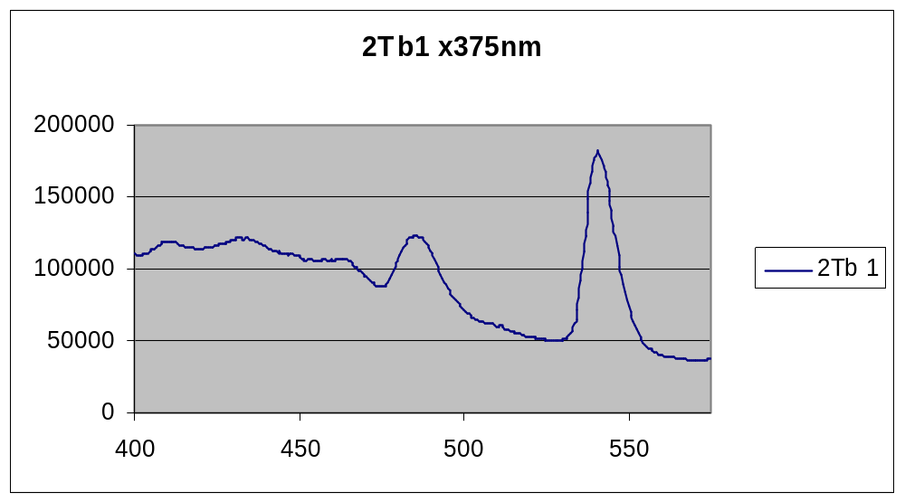
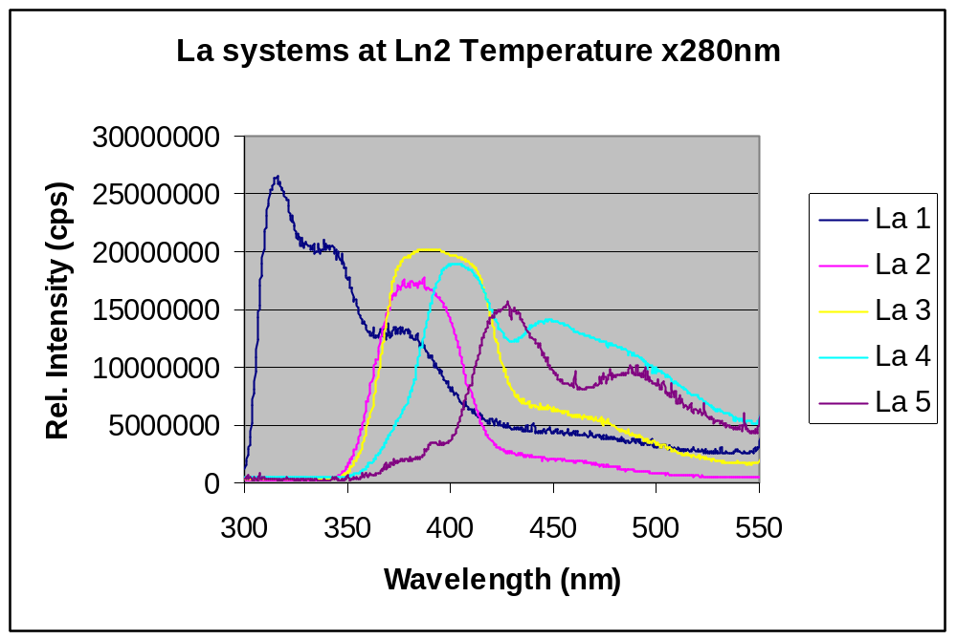
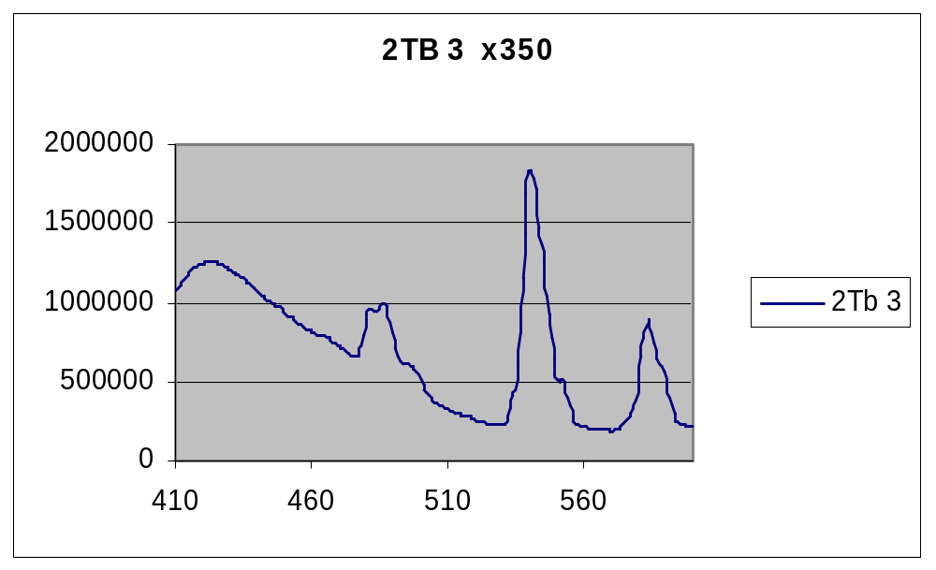
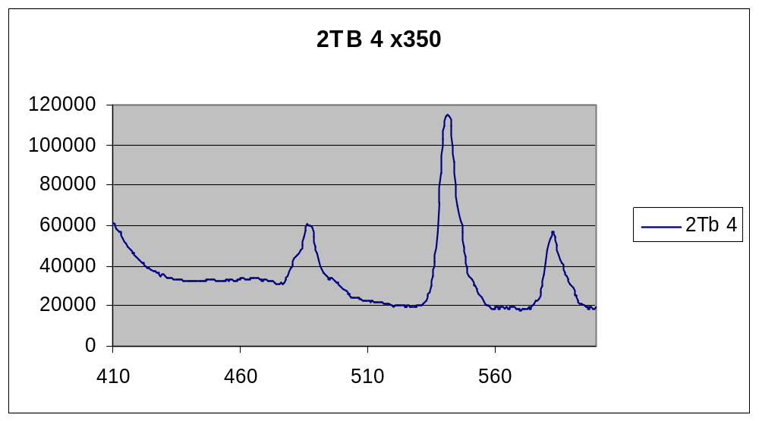
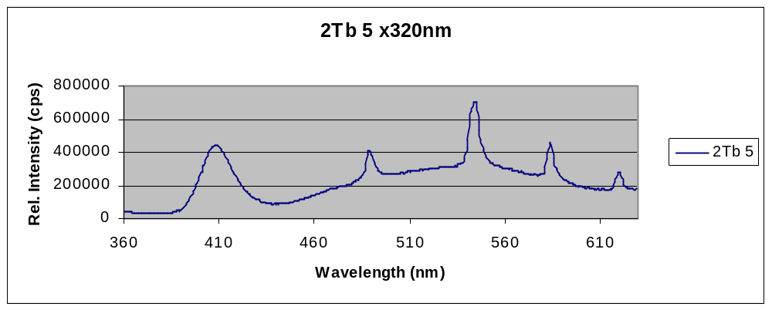
“Tunable” Photoluminescence and Energy Transfer of Terbium(III) Dicyanoaurate(I) and Dicyanoargentate(I) Powders
Henry J. Tracy¹, Jerome L. Mullin², Julie Clarissa F. Colis³, and Judith Haug², and Howard H. Patterson³
¹Department of Chemistry, University of Southern Maine, Portland, Maine 04104
²Department of Chemistry, University of New England, Biddeford, Maine 04005
³Department of Chemistry, University of Maine, Orono, Maine 04469
Introduction
The area of energy transfer involving lanthanide ions is of great interest because of numerous applications in fields as diverse as biochemistry, materials science, and energy and information transfer. Energy transfer from dicyanoaurate(I) and dicyanoargentate(I) donors to lanthanide ion acceptors has been demonstrated.¹ The tunability of the excitation and emission from such species is potentially useful in a range of technological applications.
Single crystals of Tb[Au(CN)₂]₃ and Tb[Ag(CN)₂]₃ have exhibited temperature-dependent photoluminescence.¹ Here we report the preparation and room-temperature and low temperature excitation and emission characteristics of powders of the above compounds as well as a mixed donor system of the form Tb[Ag_{x}Au_{(1-x)}(CN)₂]₃ (0  x  1). A comparison to the characteristics of the corresponding single crystals is included.
The Tb[Ag_{x}Au_{(1-x)}(CN)₂]₃ donor system is compared to the non-emmisive La[Ag_{x}Au_{(1-x)}(CN)₂]₃ donor system.
Comparison of Tb Series vs. La Series Excitation Spectra
Tb at Ln₂ Tb at RT La at Ln₂ and RT
The greatest amount of energy transferred to tb3+ from moleculer emmission is in the 2Tb 2 system - 58%.
Tb(NO₃)₃
Tb(NO₃)₃
La[Au_{x}Ag_{1-x}(CN)₂]₃ at room temp
Tb[Ag(CN)₂]₃
Tb[Ag(CN)₂]₃
Preparation of Ln[Ag_{x}Au_{(1-x)}(CN)₂)]₃ Powders
Single crystal samples with targeted stoichiometries are, at best, difficult and time-consuming to prepare. Powder samples with the compositions listed below were prepared easily and reproducibly by precipitation from stoichiometric amounts of aqueous stock solutions of Tb(NO₃)₃ or La(NO₃)₃ and the appropriate amounts of KAg(CN)₂ and/or KAu(CN)₂. Subsequent washing with water eliminated KNO₃ from the powders (luminescence characteristics of washed and unwashed powders were found to be identical).
Sample mol %Au vs. Ag
Designation
Tb1 / La1 0%
Tb2/ La2 25%
Tb3 / La3 50%
Tb4 /La4 75%
Tb5 / La5 100%
La[Au_{x}Ag_{1-x}(CN)₂]₃ at Ln₂ temp
Tb[Au_{0.25}Ag_{0.75}(CN)₂]₃
Tb[Au_{0.25}Ag_{0.75}(CN)₂]₃
Major Conclusions
A. Powders of mixed donor systems with fixed stoichiometry are readily and reproducibly prepared by precipitation reactions.
B. Evidence for energy transfer from the Ag/Au(CN)₂⁻ donor to Tb³⁺ is provided by changes in photoluminescence as the ratio of Au to Ag in the donor is changed, resulting in the ability to excite Tb³⁺ emission at excitation wavelengths where the Tb³⁺ does not absorb directly.
C. Evidence for energy transfer from the donor system to Dy³⁺ is apparent only when the donor’s Au/Ag ratio is > 0.5. In contrast to behavior observed below 78K, Dy³⁺ emission appears to be quenched when the Au/Ag ratio is < 0.5. The lack of a spectral overlap region between the donor and Dy³⁺ is thought to account for the relative inefficiency of energy transfer, at least at room temperature.²
D. Washed and unwashed powders have identical photophysical properties.
E. The behavior of Tb³⁺ and
Tb[Au_{0.5}Ag_{0.5}(CN)₂]₃
Tb[Au_{0.5}Ag_{0.5}(CN)₂]₃
Results
I. Powders Dispersed in Room Temperature and Ln₂ Temperature
A. Emission Behavior
The molecular Terbium emission characteristics do not change as the amount of Au in the preparations is increased (e.g., in moving from Tb1 to Tb5). In all cases, the Tb³⁺ emission wavelengths do not change, but the Tb³⁺ emission intensities are tunable by varying the Au/Ag donor ratio. The intensity of the molecular emission band attributed to Au_{x}Ag_{1-x}(CN)₂⁻ (~405-410 nm) and the ratio of molecular emission to Tb³⁺ emission increases as the Au/Ag ratio increases, as expected. The pattern of emission behavior is easily observed by comparing the spectra shown in the next two columns.
B. Excitation Characteristics
Clearly, the excitation maxima for the Tb³⁺ emissions shift to longer wavelengths as the amount of Au in the systems increases; this effect is most dramatic in moving from 0% Au in sample Tb1 to about 50% Au in sample Tb3. The effect, is not present, in the non emissive La³⁺ series. This is evidence supporting the hypothesis that energy transfer occurs from the Au/Ag(CN)₂⁻ donor to Tb³⁺ emitters since, as % Au increases, Tb³⁺ is excited efficiently at wavelengths at which Tb³⁺ does not absorb directly.
Tb[Au_{0.75}Ag_{0.25}(CN)₂]₃
Tb[Au_{0.75}Ag_{0.25}(CN)₂]₃
Tb[Au_{0.75}Ag_{0.25}(CN)₂]₃
Tb[Au_{0.75}Ag_{0.25}(CN)₂]₃
Work in Progress
Continuing studies in this area are focused on:
a. The photophysical behavior of the Ag/Au(CN)₂⁻ donors in the presence of non-emitting lanthanide ions (e.g., La³⁺).
b. Continuing investigation of the photophysical behavior of the Ag/Au(CN)₂⁻ donors in powders derived from lanthanide ions having higher and lower energy emitting states than Tb³⁺ (e.g., Dy³⁺ and Eu³⁺).
c. The photophysical behavior of the Ag/Au(CN)₂⁻ donors in powders containing mixed lanthanide ion acceptors (e.g., Tb³⁺/Eu³⁺).
d. Comparisons of the photophysical behavior of the various powders in room temperature glasses to those at reduced temperature.
Tb[Au(CN)₂]₃
Tb[Au(CN)₂]₃
Spectral Assignments for Tb³⁺ and Dy³⁺ Systems
References
1. Rawashdeh-Omary, M.A; Larochelle, C.L.; Patterson, H.H. Inorg. Chem. 2000, 39, 4527-4534.
2. Assefa, Z.; Patterson, H.H. Inorg. Chem., 1994, 33, 6194-6200.
Acknowledgements
The authors thank the American Chemical Society Petroleum Research Fund, the University of Southern Maine, and the University of New England for financial support of this work.
Tb³⁺ System
EM line Assignment
489 nm ⁵D₄  ⁷F₆
544 nm ⁵D₄  ⁷F₅
584 nm ⁵D₄  ⁷F₄
620 nm ⁵D₄  ⁷F₃
Dy³⁺ System
Note the dramatic shift in wavelength of maximum excitation of the Tb³⁺ emission bands as the proportion of Au in the systems increases.
EM line Assignment
480 nm ⁴F_{9/2}  ⁶H_{15/2}
573 nm ⁴F_{9/2}  ⁶H_{13/2}

